Slide 1
Overview of Land Use Compatibility between Sensitive Land Uses and Nuisance Sources Peter Piersol ppiersol@ortech.ca

Slide 2
This Introduction
The Proximity Issue
The Pressure Points
Available Guidance
D-6 Report & Study Examples

Slide 3
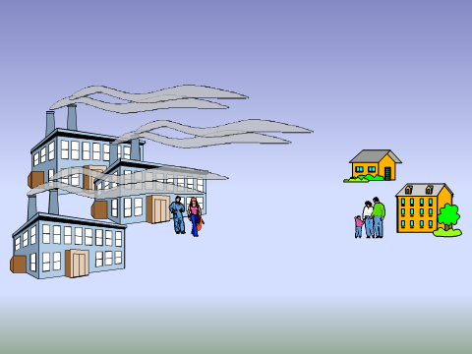
The Proximity Issue
The air Ontario Regulatory system, including noise, is primarily based on off-property impacts.
Concept of ‘Points of Impingement (POI)’, or points of potential adverse effect

Slide 4
The Proximity Issue
Points of impingement
2. (1) A reference in this Regulation to a point of impingement with respect to the discharge of a contaminant does not include any point that is located on the same property as the source of contaminant. O. Reg. 419/05, s. 2 (1).
(2) Despite subsection (1), a reference in this Regulation to a point of impingement with respect to the discharge of a contaminant includes a point that is located on the same property as the source of contaminant, if that point is located on,
(a) a child care facility; or
(b) a structure, if the primary purpose of the property on which the structure is located, and of the structure, is to serve as,
(i) a health care facility,
(ii) a senior citizens’ residence or long-term care facility, or
(iii) an educational facility.

Slide 5
The Proximity Issue
Air Points of Impingement:
All off-property ‘receptors’, including
All ground level locations including low rise structures:
Elevated structures (e.g. medium and high rise buildings);
And certain on-property locations (e.g. child care).
c.f. Noise Point of Reception; later presentation

Slide 6
The Proximity Issue
The Pressure Points
High demand for residential development
Low demand for industrial land or industrial land development
Redevelopment, Infilling and Mixed Use
Functional ‘grandfathering’ of existing industries
Tolerance of some fugitive dust, noise and odour leaving the property
Community perceptions of adverse impacts and nuisance

Slide 7
Available Guidance
2014 Provincial Policy Statement (s1.2.6 Land Use Compatibility)
The Environmental Protection Act
The 1999 Land Use Compatibility Guidelines (the so called ‘D’ Guidelines); on the MOECC website:
http://www.ontario.ca/document/d-1-land-use-and-compatibility
http://www.ontario.ca/document/d-6-compatibility-between-industrial-facilities

Slide 8
Available Guidance
D-1 Land Use And Compatibility
D-2 Compatibility between Sewage Treatment and Sensitive Land Uses
D-3 Environmental considerations for Gas or Oil Pipelines and Facilities
D-4 Land Use on or Near Landfills and Dumps
D-5 Planning for Sewage and Water Facilities
D-6 Compatibility between Industrial Facilities and Sensitive Land Uses

Slide 9
Available Guidance
Details and Clarifications:
D-1-1; D-1-2; D-1-3
D-4-1; D-4-2; D-4-3
D-5-1; D-5-2; D-5-3; D-5-4; D-5-5
D-6-1; D-6-2; D-6-3; D-6-4

Slide 10
ECA Clarification
D-6-2 Clarification
The Ministry of the Environment & Energy requires that the industrial facility, for which the Air C of A application is being made, must comply with area zoning by-law(s). If the proposal conflicts with area zoning by-laws, the application will be returned.

Slide 11
Available Guidance
NPC-300 Environmental Noise Guideline,
Noise Assessment criteria for Stationary Sources and for Land Use Planning
Ontario Regulation 419/05 Air Pollution — Local Air Quality

Slide 12
Available Guidance
Guideline A-10 Procedure For Preparing an Emission Summary and Dispersion Modelling Report
Guideline A-11 Air Dispersion Modelling Guideline for Ontario
Technical Bulletin Methodology for Modelling Assessments of Contaminants with 10-minute Average Standards and Guidelines under O.Reg. 419/05

Slide 13
Available Guidance
Halton 2014 Guidelines (Part of Halton ROPA 38; Report No. IMLC01-14):
Land Use Compatibility Guidelines Regional Official Plan Guidelines
Air Quality Guidelines Regional Official Plan Guidelines
Includes Transportation Corridors and Airports

Slide 14
A D-6 Guideline Study
1000 Metre Study Area to search for Industrial Uses
Definitions and examples of three Classes, based on noise, dust and odour:
Class | Recommended Minimum Separation Distance (m) | Potential Influence Area (m)
I | 20 | 70
II | 70 | 300
III | 300 | 1000
But the ‘actual influence area is site specific’

Slide 15
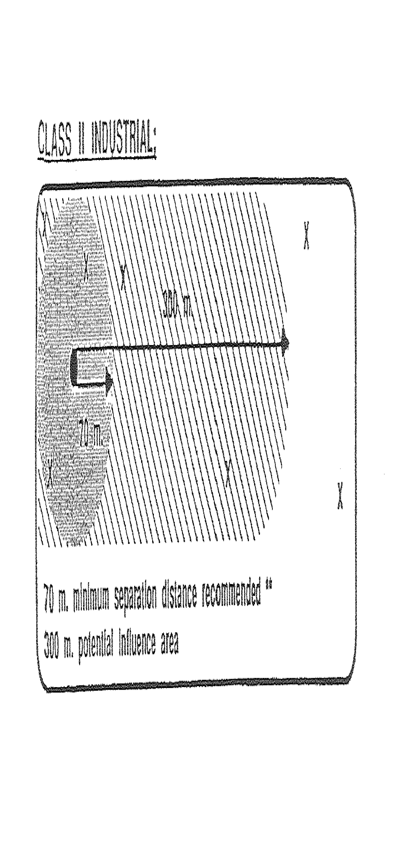
D-6 Guideline Graphic

Slide 16
A D-6 Guideline Study
Sensitive land uses (where humans or the natural environment may be adversely affected by emissions):
Designated recreational uses, public spaces
Buildings and Amenity Areas; examples include residences, senior homes, schools, day care, hospitals, churches, campgrounds

Slide 17
A D-6 Guideline Study
A D-6 Report describes
the relevant existing and proposed industries and separation distances to
existing and proposed sensitive uses based on the potential for noise, dust and odour.
Typically the report is commissioned to address encroachment of new residential on existing industry
Report may also include mitigation as appropriate

Slide 18
An Overall D Guideline Study
A full D Study Report includes:
Sewage Treatment Facilities;
Pipelines;
Landfills and Dumps;
Water Supply and Services; and
Industrial Facilities.
A full sensitivity study might also include transportation corridors, airports and the like.

Slide 19
D-6
Example 1
Proposed Townhouses Adjacent to Small Sewage Treatment Plant:
Odour Issues
Complaint History
Community Odour Observations
Consultations with Regional Government
Peer Reviews

Slide 20
D-6
Example 2
Proposed Housing Near Industrial Park:
Survey of industrial & commercial facilities
Categorize facilities & identify separation distances
Site Visit Observations
Discussions with Municipal, Regional Government & MOECC

Slide 21
Thank you

